Slide 1
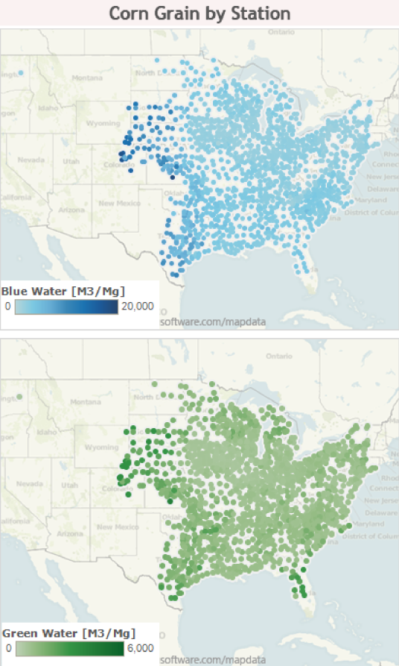
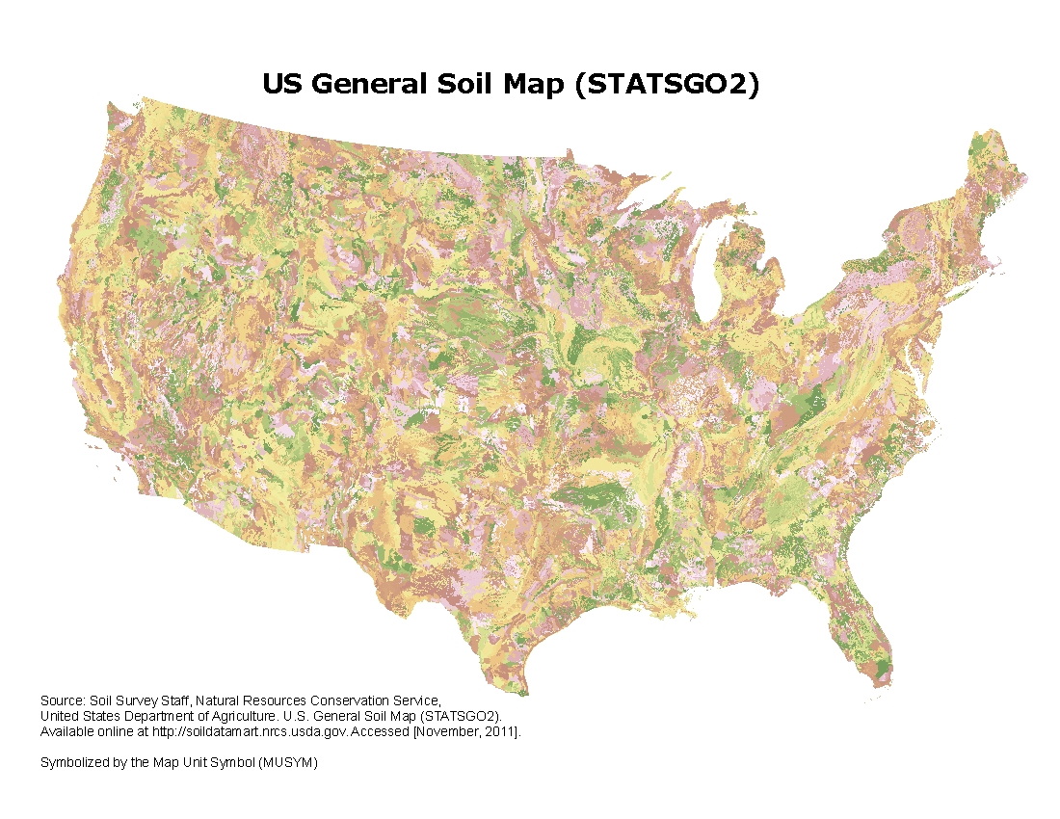
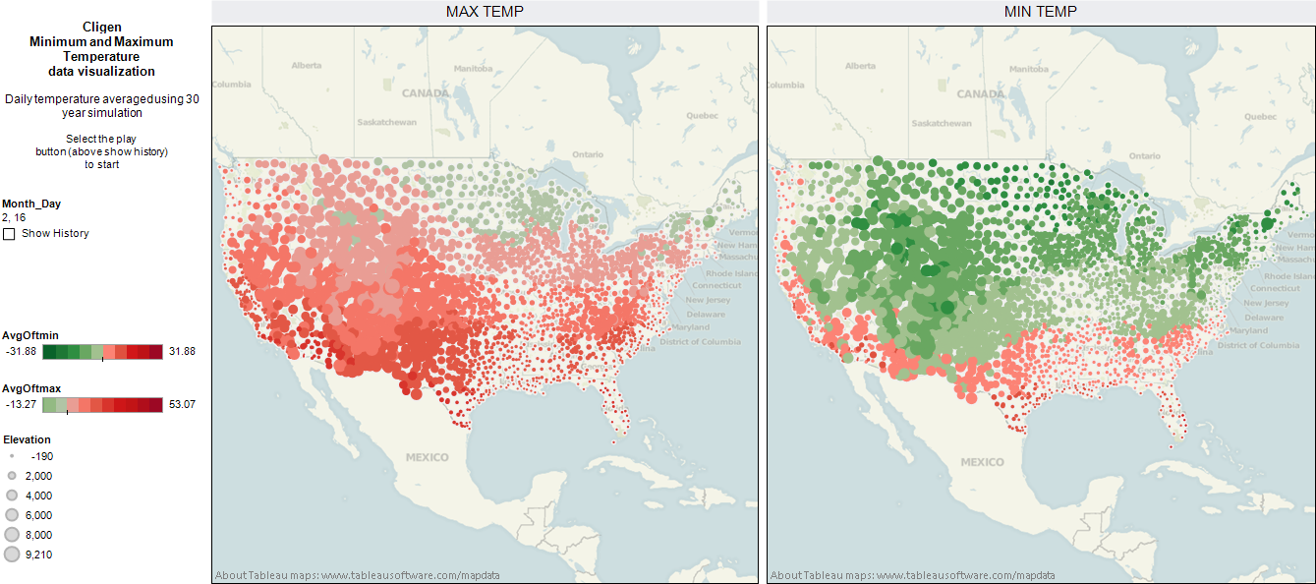
BioSpatial H₂O Model
Scenario-based water footprinting of agricultural feedstocks
Combines soil and climate data layers to estimate rain water (green) use and potential irrigation water (blue) use

